Slide 1
From science to standards and harmonised OECD Test Guidelines NanoHarmony Training

Slide 2
Conditions of use
The training material was developed within the project NanoHarmony (EU Horizon 2020 No. 885931). Attribution-NonCommercial 4.0 International (CC BY-NC 4.0):
You are free to:
Share — copy and redistribute the material in any medium or format
Adapt — remix, transform, and build upon the material
The licensor cannot revoke these freedoms as long as you follow the license terms.
Under the following terms:
Attribution — You must give appropriate credit, provide a link to the license, and indicate if changes were made. You may do so in any reasonable manner, but not in any way that suggests the licensor endorses you or your use.
NonCommercial — You may not use the material for commercial purposes.
No additional restrictions — You may not apply legal terms or technological measures that legally restrict others from doing anything the license permits.

Slide 3
NanoHarmony – The project
Develop and validate Test Methods for OECD TGs/GDs
The NanoHarmony legacy
White Paper
Training Material
Formation of a network to interact with all relevant stakeholders
Regular Online Workshops
TGs and GDs for NMs
Process Mentor
Develop a structure to translate science into test methods used in regulation
www.nanoharmony.eu
+ 18 int. assoc. partners
Notes:
The NanoHarmony project was funded through Europe’s Horizon 2020 research and innovation programme. Its mission has been to support the development of Test Guidelines and Guidance Documents for eight endpoints where nanomaterial-adapted test methods have been identified as a regulatory priority. These include endpoints on physicochemical properties (dissolution in water and biological media, surface chemistry, dustiness, and determination of nanomaterial concentrations in biological samples), on environmental endpoints (determining apparent bioaccumulation in fish, a scoping review on a tiered approach for bioaccumulation testing, recommendations for acute tests with nanomaterials in algae, daphnids and fish), and on human health endpoints (toxicokinetics, in vitro approach for intestinal fate). NanoHarmony coordinates the collection and use of available data and information to support the finalisation of these test method developments.
Furthermore, NanoHarmony has analysed processes in test method development to identify obstacles and options with the aim of further streamlining the TG development processes and to improve the engagement of key stakeholders therein. This has resulted in a White Paper with recommendations, and an online Process Mentor and Training Material to support stakeholders in the development of test guidelines.
This training material has been developed to increase awareness among the different stakeholders on OECD, the OECD test guidelines programme and the process of developing test guidelines.

Slide 4
NanoHarmony Training: From science to standards and harmonised OECD Test Guidelines
This set of slides provides a low-level entry into the topic of standards and harmonised OECD Test Guidelines and how science can contribute to this. The training set provides essential information on the topics of harmonisation of test methods, OECD and its relevant committees and documents, and the process of OECD Test Guideline development.
This material was developed mid-2023.
The Training Material is divided into 4 different modules, each focussing on a specific topic:
Importance of standardised and harmonised test methods What are harmonised test methods, why are they relevant and what are resulting benefits? How can my science contribute to an OECD Test Guideline? How are standards and harmonised test methods used? How does OECD fit in with other standardisation activities?
The OECD and its relevant committees What is the OECD and which committees are relevant? What is the political structure of the OECD? Who are National Coordinators?
The different documents in the OECD Test Guidelines Programme What are the different OECD documents? What are advantages of getting involved in their development?
The process of development of OECD documents How is the OECD Test Guideline development process structured? Which stakeholders are involved in the development/revision/adaptation of OECD TG/GDs? How can stakeholders get engaged in the process?
Further, more detailed information on the different phases of the OECD process is provided by the
www.testguideline-development.org

Slide 5
Importance of standardised and harmonised test methods
Module 1
NanoHarmony Training:
From science to standards and harmonised OECD Test Guidelines

Slide 6
Questions to the audience
Do you know that Test Guidelines exist?
What level of direct experience have you had with the OECD Test Guideline Programme so far?
How many Test Guidelines / Guidance Documents / Standards have you used in your own work in any way?
Have you developed or contributed any standards or OECD Test Guidelines in any of your work?
Are you currently working in a scientific project that has any activities around contributing to standards or OECD Test Guidelines?
…
Q&A
Notes:
The questions can be used for asking the audience prior to the training in order to learn more about the knowledge status of the audience.

Slide 7
Importance and advantages of standardised and harmonised test methods
Standardised and harmonised test methods are important for scientists, regulators, industry, testing laboratories, the general public, …
Facilitate knowledge transfer
Safety assessment of chemicals and (new) materials
Reduce global trade barriers
Reduce number of (animal) test needed
Testing safety during innovation process and during registration needs to be coherent
Ensure comparability of results
Can reduce operational costs
Facilitate international cooperation
Help to make regulation all over the world enforceable
Opening new research fields
…
Notes:
Standardised and harmonised test methods enable the comparison of test results, generate trust in data obtained by performing tests following standardised and harmonised test methods.
Thereby these standardised and harmonised test methods are important for various different stakeholders.
Besides many other advantages, standardised and harmonised test methods are essential for regulatory purposes:
Regulation has to keep pace with innovation to assure a safe and trustworthy development of new techniques and materials.
In order to make regulation enforceable, standardised and harmonised test methods are essential.
It is particularly important to have test methods ready and up-to-date that are applicable to the respective materials, usable to test for the required endpoints and operable by testing laboratories and industries.

Slide 8
Standardised and harmonised test methods are used world-wide
International standards
ISO, CEN,…
OECD Test Guidelines
National standards
CYS (CY), DIN (DE), ILNAS (LU),
NEN (NL), BSI (UK), ...
Science
General public
Regulators
Industry
Industry associations
…
Testing laboratories
Non-profit organisations
Notes:
There are different standardisation and harmonisation bodies with different purposes, different organisational structures and different ways of standardisation and harmonisation of test methods.
Some of them act globally, whereas others are producing national standards.
Many of the international standards are further used in national regulation. Committees at national level mirror those at international level and support transfer of knowledge.

Slide 9
Standardised versus harmonised test methods
Standardised test methods
Developed and validated by different standardisation bodies (e.g. ISO, CEN, national standardisation bodies)
Market need
More industry driven
Communication among industry
The development process usually takes about 3 years
Purchase for (small) fee
Harmonised test methods
Developed and validated by the Organisation of Economic Co-operation and Development (OECD)
Regulatory need
More government driven
Data gathering and enforcement of legislation
The development process can take 2-5 years on average
Public access
ISO www.iso.org
Organisation of Economic Co-operation and Development (OECD) www.oecd.org
Notes:
The main difference of standardised and harmonised test methods is there driving force: Standardised methods are mainly driven by needs from industry. Harmonised methods are mainly driven by regulatory needs. Hence, they fulfil specific purposes. This is also reflected in the way they are described and in their content.
The NanoHarmony Training Material is focused on the OECD processes.
When the NanoHarmony Training Material indicates OECD TGs/GDs it may use the term “harmonised test methods”.

Slide 10
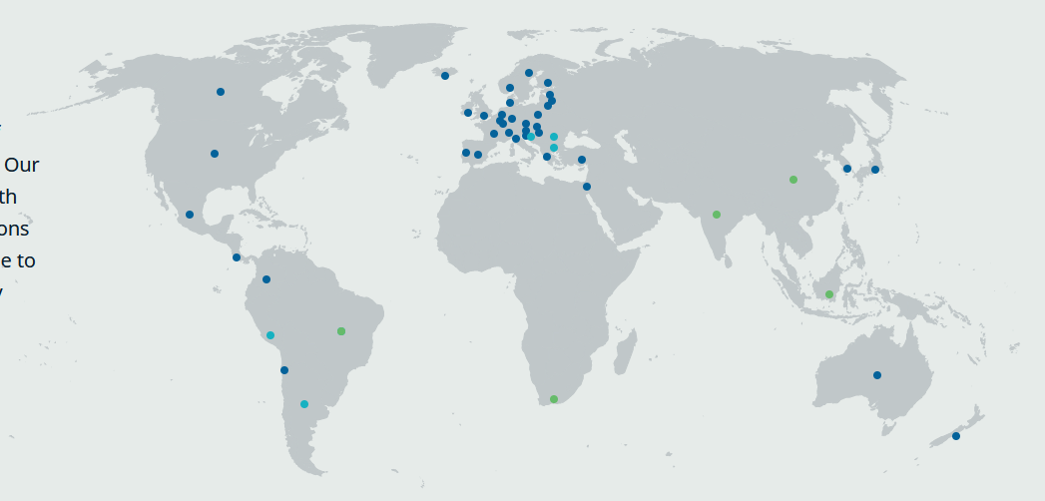
Organisation of Economic Co-operation and Development (OECD)
Intergovernmental organisation
38 Member countries representatives and European Commission
Industry representation (Business & Industry Advisory Committee, BIAC)
Animal welfare organisations (International Council on Animal Protection in OECD Programmes, ICAPO)
Green NGOs
Other partners (e.g. China, Malaysia, Thailand, South Africa)
International Organisations (e.g. WHO, UNITAR, UNEP, ISO)
OECD covers more than 27 different topics
One of them is chemical safety and biosafety
Member countries
Accession candidates
Key partners
Organisation of Economic Co-operation and Development (OECD) www.oecd.org
Notes:
Together with governments, policy makers and citizens, OECD works on establishing evidence-based international standards and finding solutions to a range of social, economic and environmental challenges.
From improving economic performance and creating jobs to fostering strong education and fighting international tax evasion, OECD provides a unique forum and knowledge hub for data and analysis, exchange of experiences, best-practice sharing, and advice on public policies and international standard-setting.

Slide 11
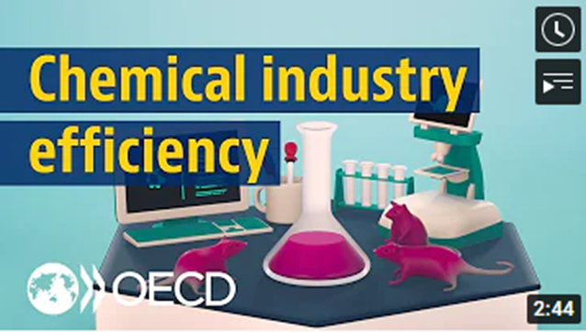
Mutual Acceptance of Data (MAD)
Helps to avoid conflicts or duplication in national requirements
Provides a common basis for cooperation among national authorities
Avoids creating non-tariff barriers to trade
Saves the chemicals industry the expense of duplicate testing for products which are marketed in more than one country
OECD Member countries and full adherents have agreed that a safety test carried out in accordance with the OECD Test Guidelines and Principles of Good Laboratory Practice in one OECD Member country must be accepted by other OECD Member countries for assessment purposes
“tested once, accepted for assessment everywhere”
Test study data shall be accepted, but interpretation and exact use of the data may differ between countries.
https://oe.cd/chemicals-costs
Mutual Acceptance of Data (MAD) www.oecd.org/chemicalsafety/testing/mutualacceptanceofdatamad.htm
Notes:
The mutual acceptance of data is an important cornerstone of the OECD Chemicals Programme.
It is a legally binding agreement composed of three OECD Council Acts (adopted by OECD ambassadors):
The 1981 Council Decision on the Mutual Acceptance of Data in the Assessment of Chemicals (revised in 1997) that states that test study data generated in any member country in accordance with OECD Test Guidelines and Principles of Good Laboratory Practice (GLP) shall be accepted in other member countries for assessment purposes and other uses relating to the protection of human health and the environment.
The 1989 Council Decision-Recommendation on Compliance with Principles of Good Laboratory Practices which establishes procedures for monitoring GLP compliance through government inspections and study audits as well as a framework for international liaison among monitoring and data-receiving authorities.
The 1997 Council Decision on the Adherence of Non-Member countries to the Council Acts related to the Mutual Acceptance of Data in the Assessment of Chemicals that sets out a step-wise procedure for non-OECD economies to take part as full members in this system.
On its website OECD states that “By reducing duplication, and creating a framework for the sharing of work, the MAD system saves governments and industry around € 309 million each year, as well as reduces the number of animals used in such testing.”
The website also provides a short youtube-video (2m44s) that explains the MAD.

Slide 12
OECD Test Guidelines are part of the Mutual Acceptance of Data
“tested once, accepted everywhere”
Chemicals / Nanomaterials
Test Guidelines
Good Laboratory Practice
A single quality standard should be applied for testing of all chemical substances
A single quality standard for test facilities throughout OECD
Mutual Acceptance of Data (MAD)
Legally binding on OECD Member countries and other MAD Adherents*
*Argentina, Brazil, India, Malaysia, Singapore, South Africa and Thailand
Notes:
This schematic summarises how both OECD Test Guidelines and OECD GLP form the cornerstones of the MAD agreement.

Slide 13
What are advantages for scientists of getting involved in test method development?
New network and opportunities created during development (e.g. interaction with National Coordinators and experts)
Gaining valuable experience (e.g. to find a job in industry or risk assessment)
Papers are cited more if they are useful for regulators (e.g. for an OECD dossier)
Production of regulatory usable science, i.e. your science will be used (e.g. Mutual Acceptance of the Data)
Identification of new fields and scientific questions (e.g. new endpoints, new materials, new safety assessments)
Contribution to a safer and more sustainable world
…
Notes:
For scientists (and other experts and stakeholders), there are different ways to contribute to standardisation and harmonisation of test methods.
As a result, there can be several benefits that come with the involvement:
The interaction with the National Coordinator as well as with other experts offers a new network and opportunities for a close connection with the scientific community.
When participating in the standardisation and harmonisation processes, experience is gained which can be valuable for subsequent positions in industry etc.
Papers with regulatory relevant topics are often cited within the context of regulatory developments.
In addition, following standardised and harmonised methods when performing science can improve the scientific work, facilitate repetition of experiments and thereby also contributes to a higher rate of citation.

Slide 14
Potential ways to include scientific work in standardisation and harmonisation efforts
Development of experimental procedures
Establishment of standard operating procedures (SOPs)
SOPs that can be further validated
More focus on regulatory needs
Broader validation on reproducibility, transferability of method
Keep in mind: a SOP is not (yet) a Test Guideline or a standard
Adverse outcome pathways (AOPs) can help structuring a series of Test Guidelines to get information on the different key events
Commenting of draft documents and contribution to expert groups
…
SOP
Adverse outcome pathways:
https://www.oecd.org/chemicalsafety/testing/adverse-outcome-pathways-molecular-screening-and-toxicogenomics.htm
Draft Test Guidelines for public comments
www.oecd.org/chemicalsafety/testing/chemicalstestingdraftoecdguidelinesforthetestingofchemicals-sections1-5.htm
Notes:
There are different ways how scientific work can be of use for standardisation and harmonisation.
It is important to think about whether the science fulfils a regulatory need.
Note that not every SOP needs to become a Test Guideline or standard to become useful.
The OECD launched a new programme on the development of Adverse Outcome Pathways (AOP) in 2012.
An AOP is an analytical construct that describes a sequential chain of causally linked events at different levels of biological organisation that lead to an adverse health or ecotoxicological effect.
AOPs are the central element of a toxicological knowledge framework being built to support chemical risk assessment based on mechanistic reasoning.

Slide 15
Take Home Messages
Standards – industry driven, Harmonised test methods – government driven
MAD: “tested once, accepted for assessment everywhere”
Standards and harmonised test methods are essential for all stakeholders
Getting involved as a scientist in the TG development is important and advantageous
A Standard Operating Procedure (SOP) is not (yet) a Test Guideline or a standard
OECD TG/GD Process Mentor
www.testguideline-development.org

Slide 16
Sources for further information
OECD www.oecd.org
ISO www.iso.org
CEN ww.cencenelec.eu
Mutual Acceptance of Data (MAD) www.oecd.org/env/ehs/mutualacceptanceofdatamad.htm – video www.youtube.com/watch?v=dD7e1sfsh3A&t=6s
OECD Test Guidelines Programme www.oecd.org/chemicalsafety/testing/oecd-guidelines-testing-chemicals-related-documents.htm
Adverse Outcome Pathways (AOPs) at OECD www.oecd.org/chemicalsafety/testing/adverse-outcome-pathways-molecular-screening-and-toxicogenomics.htm
NanoSafety Cluster www.nanosafetycluster.eu
NanoHarmony www.nanoharmony.eu
NanoHarmony webinars https://www.youtube.com/playlist?list=PLl8XHGDKVfG7jZ0i0mkXOua3YLkMLSCSh
NanoHarmony Webinars on

