Slide 1
From science to standards and harmonised OECD Test Guidelines
NanoHarmony Training

Slide 2
Conditions of use
The training material was developed within the project NanoHarmony (EU Horizon 2020 No. 885931). Attribution-NonCommercial 4.0 International (CC BY-NC 4.0):
You are free to:
Share — copy and redistribute the material in any medium or format
Adapt — remix, transform, and build upon the material
The licensor cannot revoke these freedoms as long as you follow the license terms.
Under the following terms:
Attribution — You must give appropriate credit, provide a link to the license, and indicate if changes were made. You may do so in any reasonable manner, but not in any way that suggests the licensor endorses you or your use.
NonCommercial — You may not use the material for commercial purposes.
No additional restrictions — You may not apply legal terms or technological measures that legally restrict others from doing anything the license permits.

Slide 3
NanoHarmony – The project
Develop and validate Test Methods for OECD TGs/GDs
The NanoHarmony legacy
White Paper
Training Material
Formation of a network to interact with all relevant stakeholders
Regular Online Workshops
TGs and GDs for NMs
Process Mentor
Develop a structure to translate science into test methods used in regulation
www.nanoharmony.eu
+ 18 int. assoc. partners
Notes:
The NanoHarmony project was funded through Europe’s Horizon 2020 research and innovation programme. Its mission has been to support the development of Test Guidelines and Guidance Documents for eight endpoints where nanomaterial-adapted test methods have been identified as a regulatory priority. These include endpoints on physicochemical properties (dissolution in water and biological media, surface chemistry, dustiness, and determination of nanomaterial concentrations in biological samples), on environmental endpoints (determining apparent bioaccumulation in fish, a scoping review on a tiered approach for bioaccumulation testing, recommendations for acute tests with nanomaterials in algae, daphnids and fish), and on human health endpoints (toxicokinetics, in vitro approach for intestinal fate). NanoHarmony coordinates the collection and use of available data and information to support the finalisation of these test method developments.
Furthermore, NanoHarmony has analysed processes in test method development to identify obstacles and options with the aim of further streamlining the TG development processes and to improve the engagement of key stakeholders therein. This has resulted in a White Paper with recommendations, and an online Process Mentor and Training Material to support stakeholders in the development of test guidelines.
This training material has been developed to increase awareness among the different stakeholders on OECD, the OECD test guidelines programme and the process of developing test guidelines.

Slide 4
NanoHarmony Training: From science to standards and harmonised OECD Test Guidelines
This set of slides provides a low-level entry into the topic of standards and harmonised OECD Test Guidelines and how science can contribute to this. The training set provides essential information on the topics of harmonisation of test methods, OECD and its relevant committees and documents, and the process of OECD Test Guideline development. To facilitate the use of these slides for teaching purposes, additional information is added in the notes pages.
This material was developed mid-2023.
The Training Material is divided into 4 different modules, each focussing on a specific topic:
Importance of standardised and harmonised test methods What are harmonised test methods, why are they relevant and what are resulting benefits? How can my science contribute to an OECD Test Guideline? How are standards and harmonised test methods used? How does OECD fit in with other standardisation activities?
The OECD and its relevant committees What is the OECD and which committees are relevant? What is the political structure of the OECD? Who are National Coordinators?
The different documents in the OECD Test Guidelines Programme What are the different OECD documents? What are advantages of getting involved in their development?
The process of development of OECD documents How is the OECD Test Guideline development process structured? Which stakeholders are involved in the development/revision/adaptation of OECD TG/GDs? How can stakeholders get engaged in the process?
Further, more detailed information on the different phases of the OECD process is provided by the
www.testguideline-development.org

Slide 5
The OECD and its relevant committees
Module 2
NanoHarmony Training: From science to standards and harmonised OECD Test Guidelines

Slide 6
Questions to the audience
Have you heard about OECD before?
Do you know the National Coordinator of your country already?
Which of the sections of the Test Guideline Programme would be most interesting for you?
1: Physical-Chemical properties
2: Effects on Biotic Systems
3: Environmental fate and behaviour
4: Health Effects
5: Other Test Guidelines (pesticides and their residues)
Are you familiar with different committees in the OECD (in chemicals assessment)?
Q&A
Notes:
These questions may help in getting a feel for what your audience knows already.

Slide 7
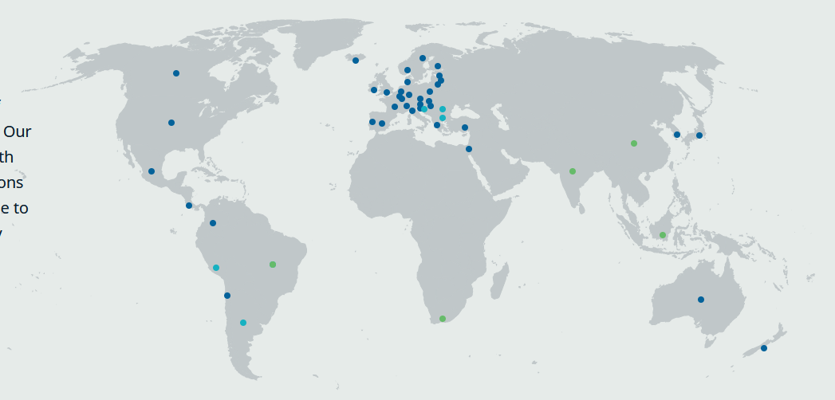
Organisation of Economic Co-operation and Development (OECD)
Intergovernmental organisation
Representatives from the 38 Member countries and European Commission
Industry representation (Business & Industry Advisory Committee, BIAC)
Animal welfare organisations (International Council on Animal Protection in OECD Programmes, ICAPO )
Green non-governmental organisations (NGOs)
Other partners (e.g. China, Malaysia, Thailand, South Africa)
International organisations (e.g. WHO, UNITAR, UNEP, ISO)
OECD covers more than 27 different topics
Member countries
Accession candidates
Key partners
Organisation of Economic Co-operation and Development (OECD) www.oecd.org
WHO: World Health Organisation; UNITAR: United Nations Institute for Training And Research; UNEP: United Nations Environment Programme; ISO: International Organization for Standardization
Notes:
Together with governments, policy makers and citizens, OECD works on establishing evidence-based international standards and finding solutions to a range of social, economic and environmental challenges.
From improving economic performance and creating jobs to fostering strong education and fighting international tax evasion, OECD provides a unique forum and knowledge hub for data and analysis, exchange of experiences, best-practice sharing, and advice on public policies and international standard-setting.

Slide 8
Organisation of Economic Co-operation and Development (OECD) - Topics
Agriculture and fisheries
Chemical safety and biosafety
Competition
Corporate governance
Corruption and integrity
Development
Digital
Economy
Education
Employment
Environment
Finance
Green growth and sustainable development
Health
Industry and entrepreneurship
Innovation
Insurance and pensions
Investment
Migration
Public governance
Regional, rural and urban development
Regulatory reform
Science and technology
Skills
Social and welfare issues
Tax
Trade
Notes:
There are many topics covered by OECD. Here we focus on chemical safety and biosafety, the topic where the OECD Test Guidelines Programme is part of.

Slide 9
OECD – Chemical safety and biosafety
The OECD Chemical Safety and Biosafety Committee (CBC) assists countries in developing and implementing policies and instruments that make their systems for managing chemicals as efficient and robust as possible, while protecting human health and the environment.
Test guidelines
Good laboratory practices
Mutual acceptance of data
Hazard assessment
Exposure assessment
Risk management of chemicals
Safety of manufactured nanomaterials
Agricultural pesticides
Biocides
Chemical accident prevention, preparedness and response
Global inventory of pollutant releases
Best available techniques to prevent and control industrial pollution
Safety of products derived from modern biotechnology
Development co-operation and sound management of chemicals
Tools supporting chemicals management
Notes:
Under the topic Chemical Safety and Biosafety OECD aims to provide support for effective safety management of chemicals. Topics in blue are the focus of this NanoHarmony training.

Slide 10
Mutual Acceptance of Data (MAD)
Helps to avoid conflicts or duplication in national requirements
Provides a common basis for cooperation among national authorities
Avoids creating non-tariff barriers to trade
Saves the chemicals industry the expense of duplicate testing for products which are marketed in more than one country
OECD Member countries and full adherents have agreed that a safety test carried out in accordance with the OECD Test Guidelines and Principles of Good Laboratory Practice in one OECD Member country must be accepted by other OECD Member countries for assessment purposes
“tested once, accepted for assessment everywhere”
Test study data shall be accepted, but interpretation and exact use of the data may differ between countries.
https://oe.cd/chemicals-costs
Mutual Acceptance of Data (MAD) www.oecd.org/chemicalsafety/testing/mutualacceptanceofdatamad.htm
Notes:
The mutual acceptance of data is an important cornerstone of the OECD chemicals programme.
It is a legally binding agreement composed of three OECD Council Acts (adopted by OECD ambassadors):
The 1981 Council Decision on the Mutual Acceptance of Data in the Assessment of Chemicals (revised in 1997) that states that test study data generated in any member country in accordance with OECD Test Guidelines and Principles of Good Laboratory Practice (GLP) shall be accepted in other member countries for assessment purposes and other uses relating to the protection of human health and the environment.
The 1989 Council Decision-Recommendation on Compliance with Principles of Good Laboratory Practices which establishes procedures for monitoring GLP compliance through government inspections and study audits as well as a framework for international liaison among monitoring and data-receiving authorities.
The 1997 Council Decision on the Adherence of Non-Member countries to the Council Acts related to the Mutual Acceptance of Data in the Assessment of Chemicals that sets out a step-wise procedure for non-OECD economies to take part as full members in this system.
On its website OECD states that “By reducing duplication, and creating a framework for the sharing of work, the MAD system saves governments and industry around € 309 million each year, as well as reduces the number of animals used in such testing.”
The website also provides a short youtube-video (2m44s) that explains the MAD.

Slide 11
OECD Test Guidelines are part of the Mutual Acceptance of Data
“Tested once, accepted everywhere”
Mutual Acceptance of Data
Legally binding on OECD Member countries and other MAD Adherents
All chemicals
(and nanomaterials)
OECD
Test Guidelines
A single quality standard should be applied for testing of all chemical substances
OECD Good Laboratory Practice
A single quality standard for test facilities throughout OECD
Notes:
This schematic summarises how both OECD Test Guidelines and OECD GLP form the cornerstones of the MAD agreement.
The OECD Member countries follow the MAD. In addition, other countries can act as adherents and also follow the MAD without being officially OECD Member countries
(e.g. Argentina, Brazil, India, Malaysia, Singapore, South Africa and Thailand).
An overview of the OECD Member countries can be found here: https://www.oecd.org/about/members-and-partners
MAD Adherents and details on the process can be found here:
https://www.oecd.org/chemicalsafety/testing/non-member-adherens-to-oecd-system-for-mutual-acceptance-of-chemical-safety-data.htm

Slide 12
OECD – Chemical safety and biosafety
Chemical and Biotechnology Committee
Working Party of National Coordinators of the Test Guidelines Programme (WNT)
Working Party on Good Laboratory Practice (WPGLP)
Working Party on Hazard Assessment (WPHA)
OECD is a consensus-based organisation
Working Party on Exposure Assessment (WPEA)
Working Party on Risk Management (WPRM)
Working Party on Manufactured Nanomaterials (WPMN)
Working Party on Pesticides (WPP)
Working Party on Biocides (WPB)
Working Party on Chemical Accidents (WPCA)
Working Party on Pollutant Release and Transfer Registers (WP-PRTR)
Working Party on Harmonisation of Regulatory insights in Biotechnology (WP-HROB)
Working Party for Safety of Novel Foods and Feeds (WP-SNFF)
OECD – Chemical safety and biosafety www.oecd.org/chemicalsafety
Notes:
The Chemical and Biotechnology Committee oversees the topic of “Chemical safety and biosafety”.
Different working parties can perform and discuss different parts of the work in details.
As the focus of this NanoHarmony training is on Test Guidelines, and in particular for nanomaterials, only the Test Guideline Programme and Manufactured Nanomaterials are discussed in the slides that follow.
More on the other topics can be found on the OECD website (see link: http://www.oecd.org/chemicalsafety).

Slide 13
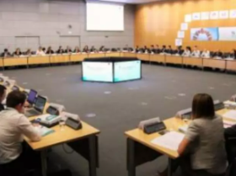
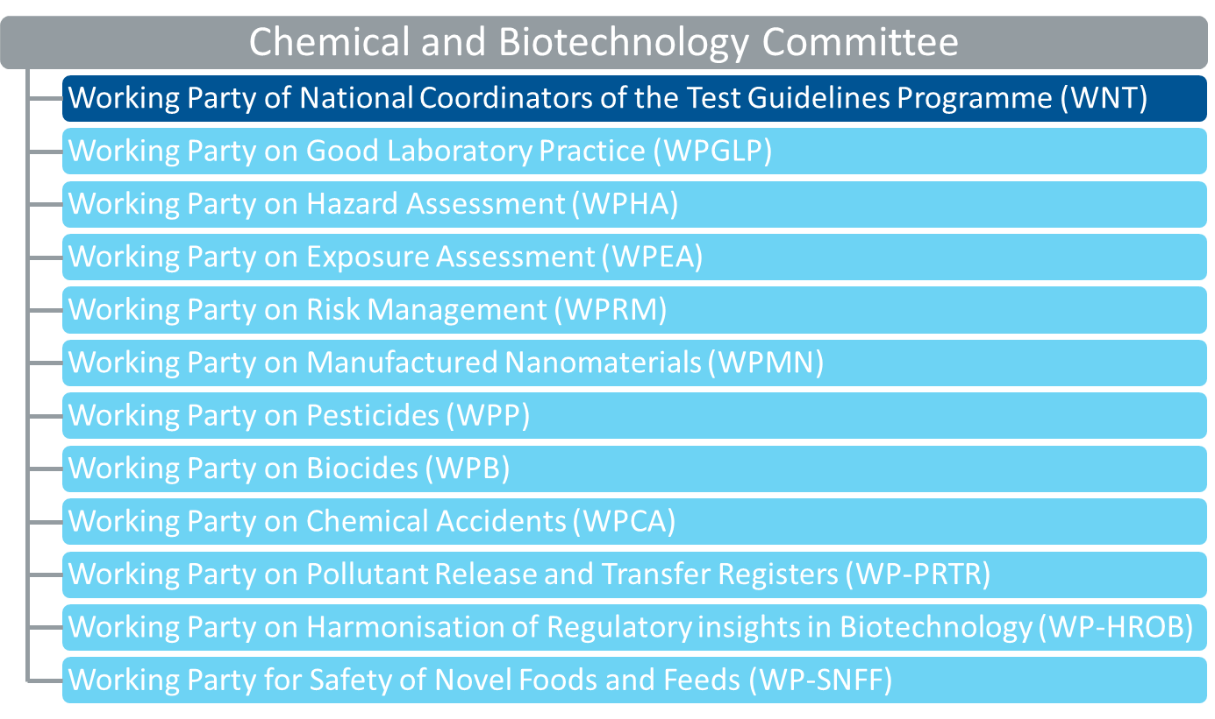
Working Group of National Coordinators of the Test Guidelines Programme (WNT)
One or more National Coordinator(s) for each OECD Member country and MAD adhering country and the European Commission (nominated by Head of Delegation in Chemical and Biotechnology Committee)
Business & Industry Advisory Committee (BIAC) (own coordinator)
Non-Governmental Organisations
International Council on Animal Protection in OECD Programmes (ICAPO) (own coordinator)
European Environmental Bureau (EEB) (own coordinator)
Secretariat team
One annual meeting, usually in April in Paris
Approval of Test Guidelines and related documents, e.g. Guidance Documents
Decisions on new projects proposed by Member countries
Review of on-going projects on the Test Guidelines Programme work plan
Discussion on programme-related issues
National Coordinators of the Test Guideline Programme www.oecd.org/chemicalsafety/testing/national-coordinators-test-guidelines-programme.htm
OECD Test Guideline Programme www.oecd.org/chemicalsafety/testing/oecd-guidelines-testing-chemicals-related-documents.htm
Notes:
The National Coordinators (NCs) from the respective OECD Member countries, non-member economies adhering to the Mutual Acceptance of Data and the European Commission (EC) have a central position in the Test Guidelines Programme.
The top half of the slide describes participants, while the lower half describes the main tasks.

Slide 14
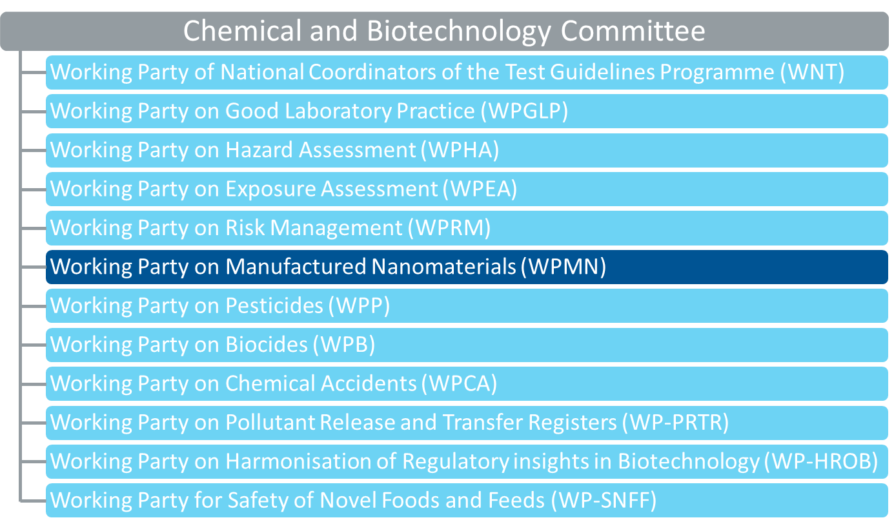
Working Party on Manufactured Nanomaterials (WPMN)
One or more representative for each OECD Member country and MAD adhering country and the European Commission (nominated by Head of Delegation in Chemical and Biotechnology Committee)
Business & Industry Advisory Committee (BIAC) (own coordinator)
Non-Governmental Organisations
International Council on Animal Protection in OECD Programmes (ICAPO) (own coordinator)
International Organization for Standardization (ISO) (own coordinator)
Secretariat team
One annual meeting, usually in June in Paris
Recommendations on needs for nanomaterials and advanced materials
Up-to-date information on the OECD activities on manufactured nanomaterials related to human health and environmental safety
Collaborates with WNT on TGs/GDs suitable for advanced/nanomaterials
Safety of manufactured nanomaterials www.oecd.org/chemicalsafety/nanosafety/
Notes:
While it started in 2006 with a focus on nanomaterials, the WPMN has proven to be a flexible group that can adjust to new developments.
Recent activities include work on advanced materials, and on safe and sustainable innovations, both in the context of chemical safety.
The top half of the slide describes participants for the WPMN, while the lower half describes the relevant activities.

Slide 15
OECD – Chemical safety and biosafety
Chemical and Biotechnology Committee
WNT
WNT
WPMN
Expert Group on Developmental Toxicity / Developmental Neurotoxicity
Steering Group on Advanced Materials
Expert Group on Ecotoxicity
Steering Group on Exposure
Expert Group on Environmental Fate and Behaviour
Steering Group on Safe & Sustainable Innovation Approach
Expert Group on Genotoxicity / Carcinogenicity
Expert Group on In vitro immunotoxicity testing
Steering Group on Testing & Assessment
Expert Group on Metal release
Expert Group on Nanomaterial Safety Testing
Joint WPMN-WNT Expert Groups (JEG)
Expert Group on Reproductive toxicity
Physico-Chemical properties of manufactured nanomaterials
Expert Group on Skin Eye Irritation / Phototoxicity
Ecotoxicity and environmental fate of manufactured nanomaterials
Expert Group on Skin Sensitisation
Nanoparticles in biological samples
Expert Group on Toxicokinetics
Expert Group on Genotoxicity / Carcinogenicity
Notes:
The Chemical and Biotechnology Committee oversees the topic of “Chemical safety and biosafety”.
Different working parties can perform and discuss different parts of the work in details.
As the focus of this NanoHarmony training is on Test Guidelines, and in particular for nanomaterials, only the Test Guideline Programme and Manufactured Nanomaterials are discussed in the slides that follow.
More on the other topics can be found on the OECD website (see link: http://www.oecd.org/chemicalsafety).

Slide 16
Take Home Messages
Organisation of Economic Co-operation and Development (OECD)
Working Party on Manufactured Nanomaterials (WPMN)
Chemical and Biotechnology Committee (CBC)
Working Group of National Coordinators of the Test Guidelines Programme (WNT)
Mutual Acceptance of Data (MAD)
OECD TG/GD Process Mentor
www.testguideline-development.org
Notes:
At the end of this module, participants of a training should have familiarised themselves with the different levels of the OECD and its work in the are of chemical safety and biosafety.

Slide 17
Sources for further information
Mutual Acceptance of Data (MAD) www.oecd.org/env/ehs/mutualacceptanceofdatamad.htm – video www.youtube.com/watch?v=dD7e1sfsh3A&t=6s
OECD Test Guidelines Programme www.oecd.org/chemicalsafety/testing/oecd-guidelines-testing-chemicals-related-documents.htm
National Coordinators of the Test Guideline Programme www.oecd.org/chemicalsafety/testing/national-coordinators-test-guidelines-programme.htm
Safety of manufactured nanomaterials – OECD www.oecd.org/science/nanosafety
Test Guidelines www.oecd.org/chemicalsafety/testing/oecdguidelinesforthetestingofchemicals.htm
Guidance and Review in the Series on Testing and Assessment www.oecd.org/chemicalsafety/testing/seriesontestingandassessmentadoptedguidanceandreviewdocuments.htm
NanoHarmony www.nanoharmony.eu
NanoHarmony webinars www.youtube.com/playlist?list=PLl8XHGDKVfG7jZ0i0mkXOua3YLkMLSCSh
NANOMET www.oecd.org/chemicalsafety/nanomet/
NanoHarmony Webinars on
Notes:
The links provided here partly go beyond the topic of this specific module.

