Slide 1
From science to standards and harmonised OECD Test Guidelines NanoHarmony Training

Slide 2
Conditions of use
The training material was developed within the project NanoHarmony (EU Horizon 2020 No. 885931). Attribution-NonCommercial 4.0 International (CC BY-NC 4.0):
You are free to:
Share — copy and redistribute the material in any medium or format
Adapt — remix, transform, and build upon the material
The licensor cannot revoke these freedoms as long as you follow the license terms.
Under the following terms:
Attribution — You must give appropriate credit, provide a link to the license, and indicate if changes were made. You may do so in any reasonable manner, but not in any way that suggests the licensor endorses you or your use.
NonCommercial — You may not use the material for commercial purposes.
No additional restrictions — You may not apply legal terms or technological measures that legally restrict others from doing anything the license permits.

Slide 3
NanoHarmony – The project
Develop and validate Test Methods for OECD TGs/GDs
The NanoHarmony legacy
White Paper
Training Material
Formation of a network to interact with all relevant stakeholders
Regular Online Workshops
TGs and GDs for NMs
Process Mentor
Develop a structure to translate science into test methods used in regulation
www.nanoharmony.eu
+ 18 int. assoc. partners
Notes:
The NanoHarmony project was funded through Europe’s Horizon 2020 research and innovation programme. Its mission has been to support the development of Test Guidelines and Guidance Documents for eight endpoints where nanomaterial-adapted test methods have been identified as a regulatory priority. These include endpoints on physicochemical properties (dissolution in water and biological media, surface chemistry, dustiness, and determination of nanomaterial concentrations in biological samples), on environmental endpoints (determining apparent bioaccumulation in fish, a scoping review on a tiered approach for bioaccumulation testing, recommendations for acute tests with nanomaterials in algae, daphnids and fish), and on human health endpoints (toxicokinetics, in vitro approach for intestinal fate). NanoHarmony coordinates the collection and use of available data and information to support the finalisation of these test method developments.
Furthermore, NanoHarmony has analysed processes in test method development to identify obstacles and options with the aim of further streamlining the TG development processes and to improve the engagement of key stakeholders therein. This has resulted in a White Paper with recommendations, and an online Process Mentor and Training Material to support stakeholders in the development of test guidelines.
This training material has been developed to increase awareness among the different stakeholders on OECD, the OECD test guidelines programme and the process of developing test guidelines.

Slide 4
NanoHarmony Training: From science to standards and harmonised OECD Test Guidelines
This set of slides provides a low-level entry into the topic of standards and harmonised OECD Test Guidelines and how science can contribute to this. The training set provides essential information on the topics of harmonisation of test methods, OECD and its relevant committees and documents, and the process of OECD Test Guideline development.
This material was developed mid-2023.
The Training Material is divided into 4 different modules, each focussing on a specific topic:
Importance of standardised and harmonised test methods What are harmonised test methods, why are they relevant and what are resulting benefits? How can my science contribute to an OECD Test Guideline? How are standards and harmonised test methods used? How does OECD fit in with other standardisation activities?
The OECD and its relevant committees What is the OECD and which committees are relevant? What is the political structure of the OECD? Who are National Coordinators?
The different documents in the OECD Test Guidelines Programme What are the different OECD documents? What are advantages of getting involved in their development?
The process of development of OECD documents How is the OECD Test Guideline development process structured? Which stakeholders are involved in the development/revision/adaptation of OECD TG/GDs? How can stakeholders get engaged in the process?
Further, more detailed information on the different phases of the OECD process is provided by the
www.testguideline-development.org

Slide 5
The different documents in the OECD Test Guidelines Programme
Module 3
NanoHarmony Training:
From science to standards and harmonised OECD Test Guidelines

Slide 6
Questions to the audience
Have you used any OECD document previously?
Do/will you use OECD Test Guidelines in your work?
Which OECD documents do you know?
Q&A
Notes:
The questions can be used for asking the audience prior to the training in order to learn more about the knowledge status of the audience.

Slide 7
The different OECD documents in the Test Guidelines Programme
There are different outputs of the Test Guidelines Programme:
Test Guideline
Harmonised test methods for regulatory chemical safety assessment
Guidance Document
Can be a test method,
or provide technical guidance for the use of one or more TGs
Review Reports
Provide overview of latest science
Study reports
Small validation studies
Validation Report
Accompanies the TG
at the end as supporting information
Not covered by Mutual Acceptance of Data (MAD)
Notes:
There are different outputs of the test guidelines programme: test guidelines (new, updated, corrected, deleted) and other documents.
These others include:
GDs to support the adequate conduct of TG studies and provide harmonisation in necessary flexibility or possible adaptations
Validation and peer-review reports to establish the foundation of new methods covered by MAD, and
Detailed review papers to explore a new area of testing.

Slide 8
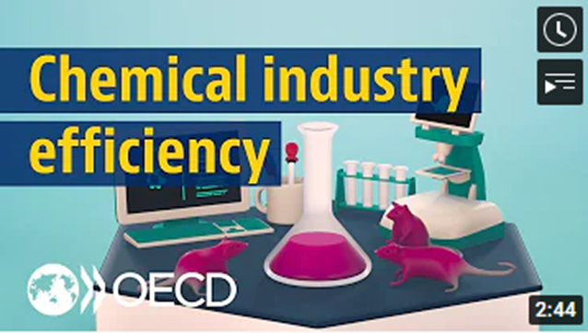
Mutual Acceptance of Data (MAD)
Helps to avoid conflicts or duplication in national requirements
Provides a common basis for cooperation among national authorities
Avoids creating non-tariff barriers to trade
Saves the chemicals industry the expense of duplicate testing for products which are marketed in more than one country
OECD Member countries and full adherents have agreed that a safety test carried out in accordance with the OECD Test Guidelines and Principles of Good Laboratory Practice in one OECD Member country must be accepted by other OECD Member countries for assessment purposes
“tested once, accepted for assessment everywhere”
Test study data shall be accepted, but interpretation and exact use of the data may differ between countries.
https://oe.cd/chemicals-costs
Mutual Acceptance of Data (MAD) www.oecd.org/chemicalsafety/testing/mutualacceptanceofdatamad.htm
Notes:
The mutual acceptance of data is an important cornerstone of the OECD chemicals programme.
It is a legally binding agreement composed of three OECD Council Acts (adopted by OECD ambassadors):
The 1981 Council Decision on the Mutual Acceptance of Data in the Assessment of Chemicals (revised in 1997) that states that test study data generated in any member country in accordance with OECD Test Guidelines and Principles of Good Laboratory Practice (GLP) shall be accepted in other member countries for assessment purposes and other uses relating to the protection of human health and the environment.
The 1989 Council Decision-Recommendation on Compliance with Principles of Good Laboratory Practices which establishes procedures for monitoring GLP compliance through government inspections and study audits as well as a framework for international liaison among monitoring and data-receiving authorities.
The 1997 Council Decision on the Adherence of Non-Member countries to the Council Acts related to the Mutual Acceptance of Data in the Assessment of Chemicals that sets out a step-wise procedure for non-OECD economies to take part as full members in this system.
On its website OECD states that “By reducing duplication, and creating a framework for the sharing of work, the MAD system saves governments and industry around € 309 million each year, as well as reduces the number of animals used in such testing.”
The website also provides a short youtube-video (2m44s) that explains the MAD.

Slide 9
OECD Test Guidelines are part of the Mutual Acceptance of Data
“tested once, accepted everywhere”
Chemicals / Nanomaterials
Test Guidelines
Good Laboratory Practice
A single quality standard should be applied for testing of all chemical substances
A single quality standard for test facilities throughout OECD
Mutual Acceptance of Data (MAD)
Legally binding on OECD Member countries and other MAD Adherents*
*Argentina, Brazil, India, Malaysia, Singapore, South Africa and Thailand
Mutual Acceptance of Data (MAD) www.oecd.org/chemicalsafety/testing/mutualacceptanceofdatamad.htm
Notes:
This schematic summarises how both OECD Test Guidelines and OECD GLP form the cornerstones of the MAD agreement.

Slide 10
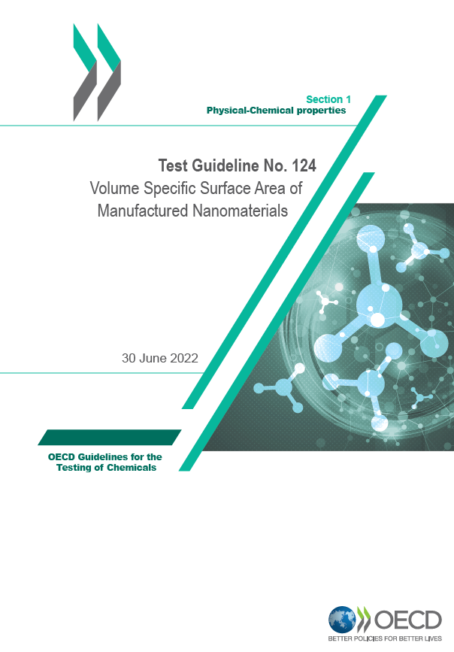
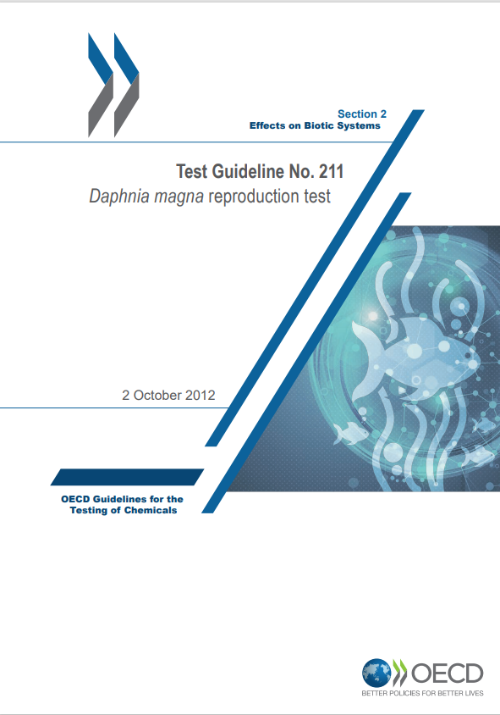
OECD Test Guidelines for the Testing of Chemicals
A unique tool for assessing the potential effects of chemicals on human health and the environment
Accepted internationally as standard methods for safety testing
Used by professionals in industry, academia and governments (industrial chemicals, pesticides, personal care products, etc.)
Form a cornerstone under the MAD system (OECD Mutual Acceptance of Data)
Five different categories:
Section 1: Physical-Chemical properties
Section 2: Effects on Biotic Systems
Section 3: Environmental fate and behaviour
Section 4: Health Effects
Section 5: Other Test Guidelines (pesticides and their residues)
Test Guidelines www.oecd.org/chemicalsafety/testing/oecdguidelinesforthetestingofchemicals.htm
Notes:
The OECD Guidelines for the testing of chemicals are a collection of the most relevant internationally agreed testing methods used by governments, industry and independent laboratories to assess the safety of chemicals. They are primarily used in regulatory safety testing and subsequent chemical notification and registration.
The set of Test Guidelines is updated on a regular basis to keep pace with progress in science and countries’ regulatory needs.
OECD-wide networks of national coordinators and national experts provide input from scientists in government, academia, and industry.

Slide 11
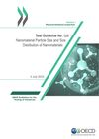
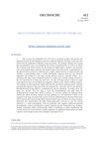
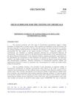
Example OECD TGs
Test Guideline No. 125 Nanomaterial Particle Size and Size Distribution of Nanomaterials
Particle size and particle size distribution measurements of nanomaterials spanning from 1 nm to 1000 nm
Includes several methods (e.g. Atomic Force Microscopy, Small Angle X-Ray Scattering, Scanning Electron Microscopy)
Test Guideline No. 211 Daphnia magna reproduction test
Assess the effect of chemicals on the reproductive output of Daphnia magna.
Young female Daphnia (the parent animals), aged less than 24 hours at the start of the test, are exposed to the test substance added to water at a range of concentrations.
The test duration is 21 days. At the end of the test, the total number of living offspring produced is assessed.
Test Guideline No. 318 Dispersion Stability of Nanomaterials in Simulated Environmental Media
Gain information on dispersion stability of manufactured nanomaterials in simulated environmental media.
Categorise tested nanomaterials into three different classes according to their dispersion stability in tested aqueous media.
Test Guideline No. 412 Subacute Inhalation Toxicity: 28-Day Study
Fully characterize test article toxicity by the inhalation route following repeated exposure for a limited period of time (28 days)
Provide data for quantitative inhalation risk assessments.
It was updated in 2017 to enable the testing and characterisation of effects of nanomaterials tested.
Groups of at least 5 male and 5 female rodents are exposed 6 hours per day for 28 days to a) the test chemical at three or more concentration levels, b) filtered air (negative control), and/or c) the vehicle (vehicle control).
Notes:
TG 125: Includes several methods (e.g. Atomic Force Microscopy (AFM), Centrifugal Liquid Sedimentation (CLS)/Analytical Ultracentrifugation (AUC), Dynamic Light Scattering (DLS), Differential Mobility Analysis System (DMAS), (Nano)Particle Tracking Analysis (PTA/NTA), Small Angle X-Ray Scattering (SAXS), Scanning Electron Microscopy (SEM), and Transmission Electron Microscopy (TEM) and describes their pros and cons.
TG211: Describes how to test for effects on reproduction of water fleas
TG318: This includes a protocol for dispersion of the material.
TG412: The 2017 update includes some specific (additional) mainly optional parameters for nanomaterials.

Slide 12
Drafting of TG
Introduction / scope
Initial considerations and limitations / applicability domain
Principle of the test
Information on the test substance
Validity of the test
Short description of the method
Detailed procedure
Data to gather and interpretation
Minimal reporting requirements
...
Discussions between method developers and regulators
(in expert group)
Issue solving attitude of all stakeholders
Notes:
There is a template available for OECD TGs. However, the content can vary depending on the subject of the TG.
Therefore it is important to discuss the content with regulators, industry, testing laboratories and other stakeholders in expert groups.
Drafting of the Test Guideline can be performed (at least partly) in parallel to the validation of the method.
While the specific scope and endpoint of the Test Guideline will determine its final form, a general ‘table of contents’ is shown here.
Different drafting/commenting rounds are usually need at the Expert Group level:
This will make sure that the results are useful and sufficiently robust for regulators.
Also other issues, e.g. those coming up in validation, need to be discussed and may lead to adaptations of the test method (protocol).
To ensure a smooth process of development, a ‘solving attitude’ is need of all stakeholders.

Slide 13
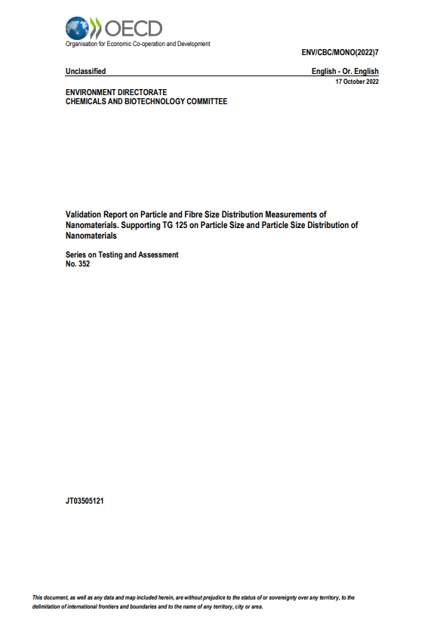
Validation report
Underpins applicability and accuracy of a TG Accompanies the TG at the end as supporting information
Details on Inter-Laboratory Comparisons (ILCs):
How was the round robin test designed?
Was it a validation of the results?
Laboratories participating
Chemicals tested
Conclusions
…
Notes:
For a Test Guideline it is mandatory to provide the details of the validation studies in a “validation report”. This is made publicly available at the same time as the Test Guideline.
The document should answer critical questions on how validation was performed and what results were.
Generally, general descriptions in the main text are accompanied by (an overview of) the raw data in Annexes (example given on the right)

Slide 14
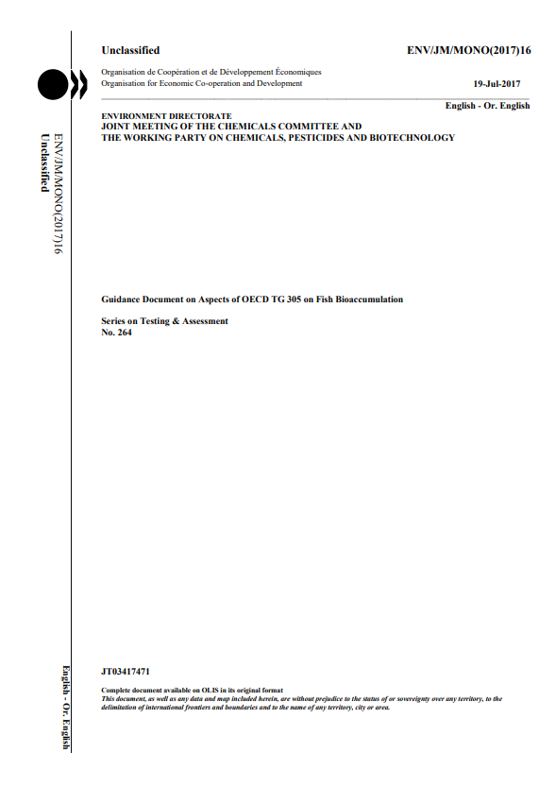
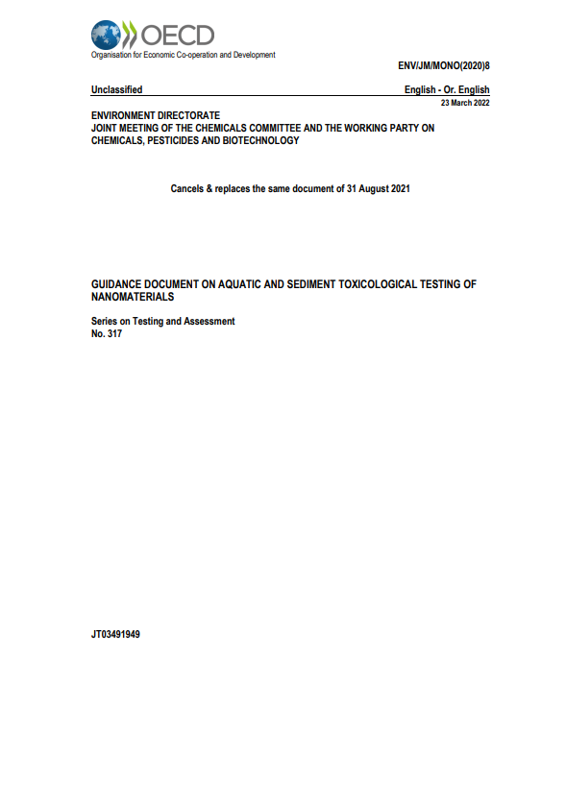
OECD Guidance & Review Documents
Provide further support in assessing the potential effects of chemicals on human health and the environment
A (more flexible/advisory) test method
Supplement one or more TGs to provide technical guidance in its/their use
Provide the state of the art of a scientific topic that might not be (yet) sufficiently mature for a TG
Not covered by the MAD system
Guidance and Review in the Series on Testing and Assessment www.oecd.org/chemicalsafety/testing/seriesontestingandassessmentadoptedguidanceandreviewdocuments.htm
Notes:
Guidance Documents are developed either to supplement a Test Guideline or to provide assistance in the Test Guideline development. Like other Test Guidelines related
documents they are advisory in nature. Consequently, the procedure for their adoption and further publication is slightly different from that for Test Guidelines (e.g. less need for validation).
Situations where the development of a Guidance Document is deemed appropriate include:
• Guidance for the conduct of field or semi-field studies;;
• Guidance for the conduct of specific studies;
• Guidance concerning the analysis of specific studies;
• Guidance concerning suggested testing strategies;
• Guidance on issues common to certain Test Guidelines
Proposals for Guidance Documents can be prepared by a member country, a scientific organisation, industry associations or other stakeholders. A schedule of work for their preparation should be agreed, and deadlines should be respected as far as possible. This information should be provided in the SPSF for such a project.

Slide 15
OECD Guidance & Review Documents
Guidance Documents can refer to one specific OECD Test Guideline and provide further details or explanations
No. 264 Guidance Document on Aspects of OECD TG 305 on Fish Bioaccumulation (further details on data interpretation)
Guidance Documents can further support several OECD Test Guidelines and act as overarching documents
No. 317 Guidance Document on Aquatic and Sediment Toxicological Testing of Nanomaterials (further support for a range of TGs for a specific group of test materials)
Study Reports can summarize small validation studies, which can form a starting point for TG development
No. 340 Study Report on a test for removal in wastewater treatment plants of gold manufactured nanomaterial (mn): activated sludge sorption isotherm
Review Reports describe the latest state of the art towards a specific scientific topic
No. 360 Detailed Review Paper on In Vitro Test Addressing Immunotoxicity With a Focus on Immunosuppression
Notes:
This slide provides some examples.

Slide 16
Test Guideline vs. Guidance Document
 | Test Guideline | Guidance Document
Mutual Acceptance of Data | ✓ | X
Standard Project Submission Form | ✓ | ✓
Content | Test method | Guidance for one / more test methods
Validation | Prerequisite | Generally limited or not necessary
Notes:
A short summary of the difference between the two types of documents.

Slide 17
Take Home Messages
Test Guidelines fall under the MAD, while other types of documents do not
A Test Guideline is accompanied by a validation report
The Mutual Acceptance of Data (MAD)
Study reports and review reports provide state of the art information etc.
Guidance Documents can provide additional information towards OECD TGs
OECD TG/GD Process Mentor
www.testguideline-development.org

Slide 18
Sources for further information
Mutual Acceptance of Data (MAD) www.oecd.org/env/ehs/mutualacceptanceofdatamad.htm – video https://www.youtube.com/watch?v=dD7e1sfsh3A&t=6s
OECD Test Guidelines Programme www.oecd.org/chemicalsafety/testing/oecd-guidelines-testing-chemicals-related-documents.htm
Test Guidelines www.oecd.org/chemicalsafety/testing/oecdguidelinesforthetestingofchemicals.htm
Guidance and Review in the Series on Testing and Assessment www.oecd.org/chemicalsafety/testing/seriesontestingandassessmentadoptedguidanceandreviewdocuments.htm
Safety of manufactured nanomaterials – OECD www.oecd.org/science/nanosafety
NanoHarmony www.nanoharmony.eu
NanoHarmony webinars https://www.youtube.com/playlist?list=PLl8XHGDKVfG7jZ0i0mkXOua3YLkMLSCSh
NanoHarmony OECD TG/GD Process Mentor www.testguideline-development.org
NANOMET www.oecd.org/chemicalsafety/nanomet/
NanoHarmony Webinars on

